Slide 1
CS231n ConvNets for spatial localization and object detection Minsik Park

Slide 2
목차
Localization
Localization as regression
Overfeat
Detection
R-CNN
SPPnet
Fast R-CNN
Faster R-CNN
YOLO

Slide 3
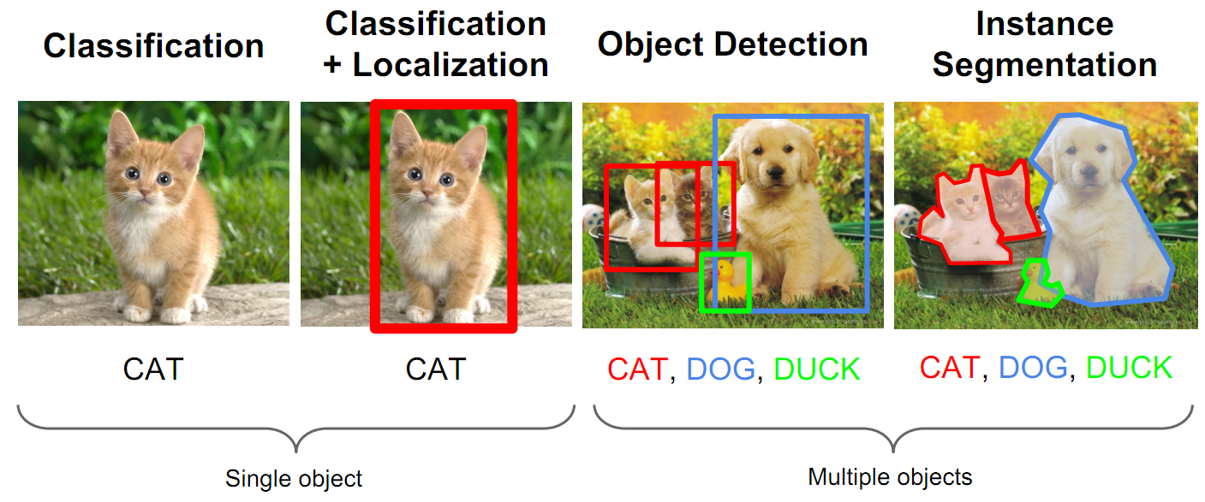
1. Localization
Computer Vision Tasks
http://cs231n.stanford.edu/slides/winter1516_lecture8.pdf

Slide 4
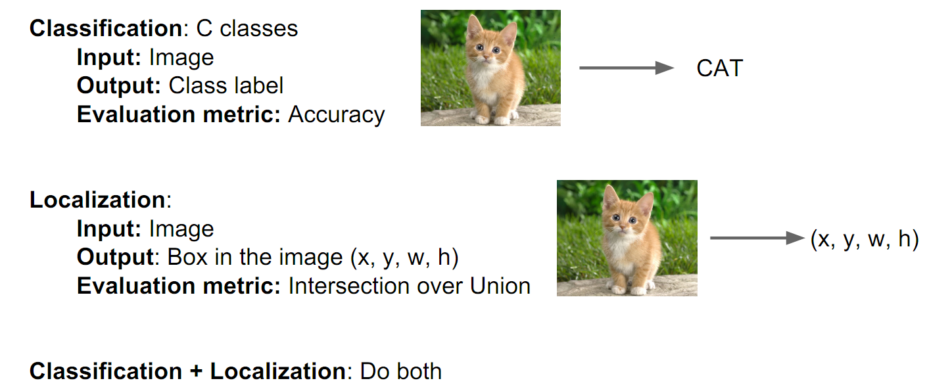
1. Localization
Classification + Localization : Task
http://cs231n.stanford.edu/slides/winter1516_lecture8.pdf

Slide 5
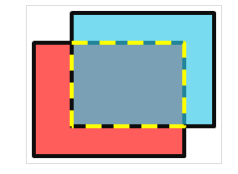
1. Localization
Evaluation metric : Intersection over Union
붉은색 상자(A1) : 실제 물체의 bounding box (ground truth)
파란색 상자(A2) : object detection 결과 bounding box
노란색 점선 : overlapped area
A inter : 두 상자의 교집합
A Union : 두 상자의 합집합(A1+A2-A inter)
Intersection over Union(IOU) = A inter / A Union
http://hellbell.tistory.com/entry/MATLAB-%ED%9A%8C%EC%A0%84-%EA%B0%80%EB%8A%A5%ED%95%9C-%EC%82%AC%EA%B0%81%ED%98%95%EB%93%A4%EC%9D%98-%EA%B2%B9%EC%B9%A8-%EA%B3%B5%EA%B0%84intersection-area-%EA%B5%AC%ED%95%98%EA%B8%B0

Slide 6
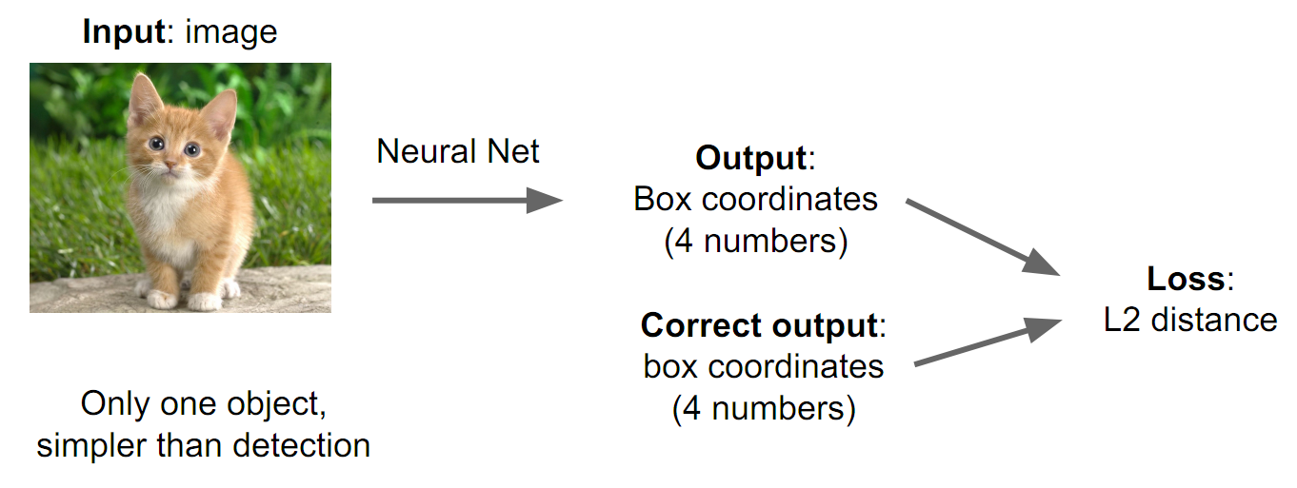
1. Localization
Localization as Regression
http://cs231n.stanford.edu/slides/winter1516_lecture8.pdf

Slide 7
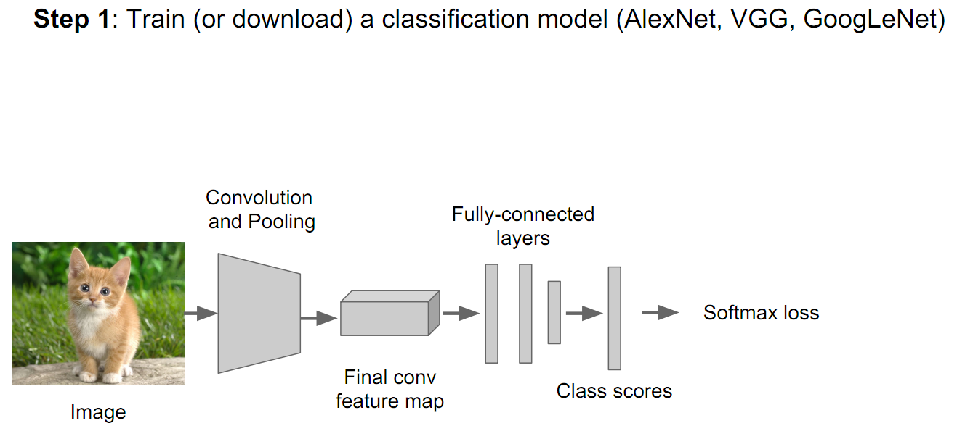
1. Localization
Localization as Regression
http://cs231n.stanford.edu/slides/winter1516_lecture8.pdf

Slide 8
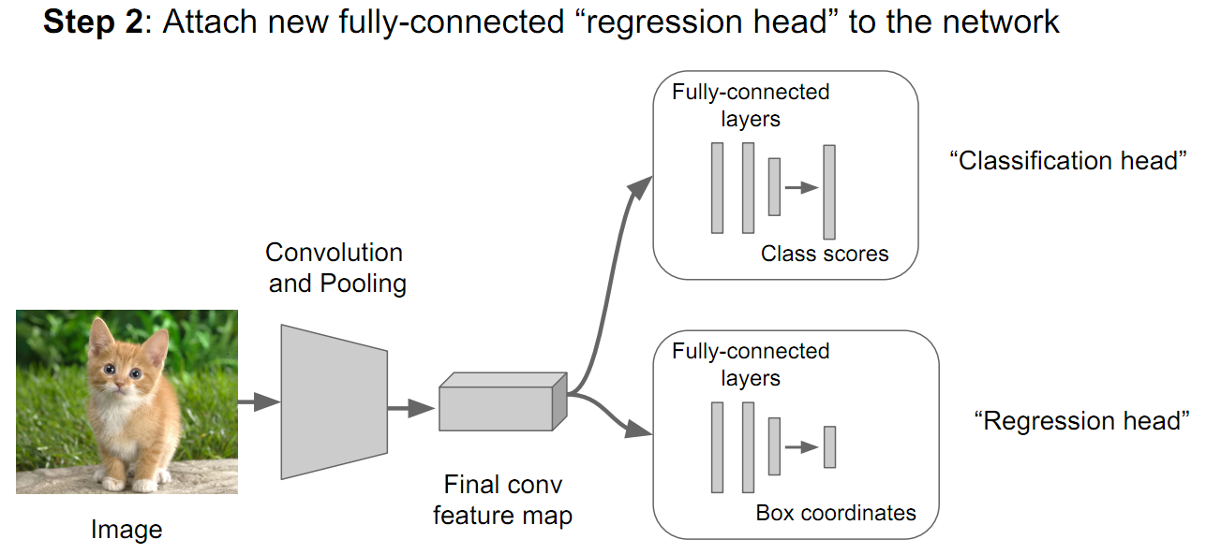
1. Localization
Localization as Regression
http://cs231n.stanford.edu/slides/winter1516_lecture8.pdf

Slide 9
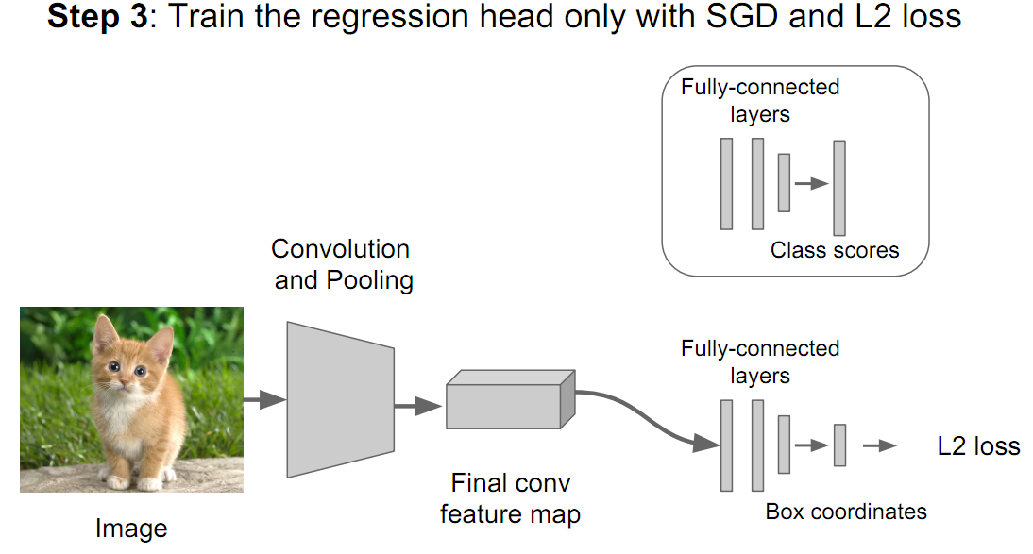
1. Localization
Localization as Regression
http://cs231n.stanford.edu/slides/winter1516_lecture8.pdf

Slide 10
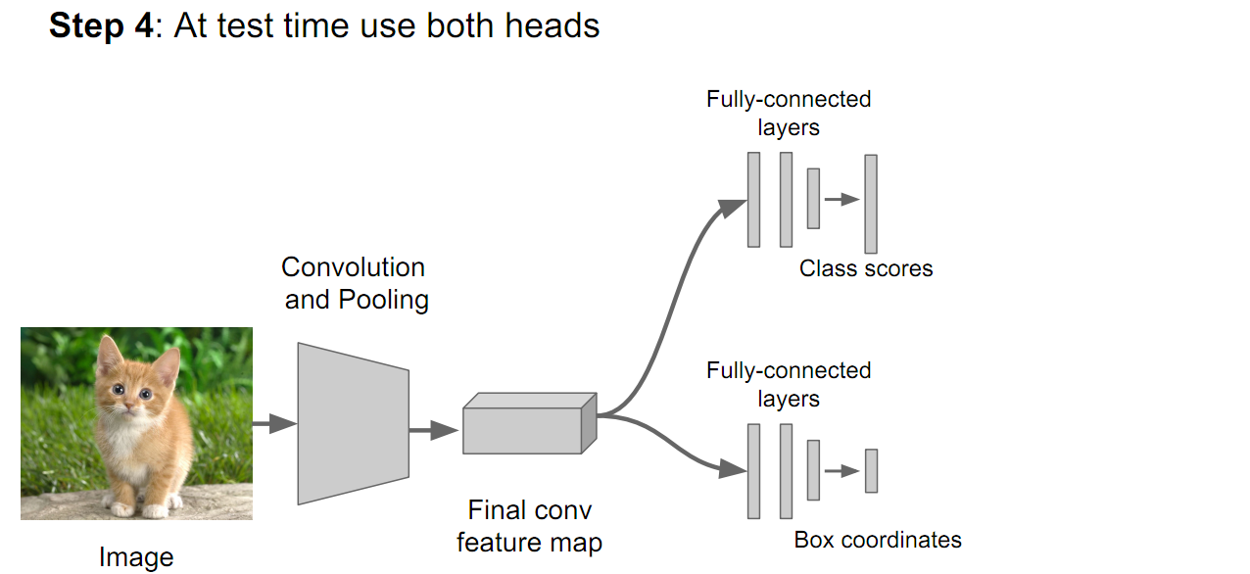
1. Localization
Localization as Regression
http://cs231n.stanford.edu/slides/winter1516_lecture8.pdf

Slide 11
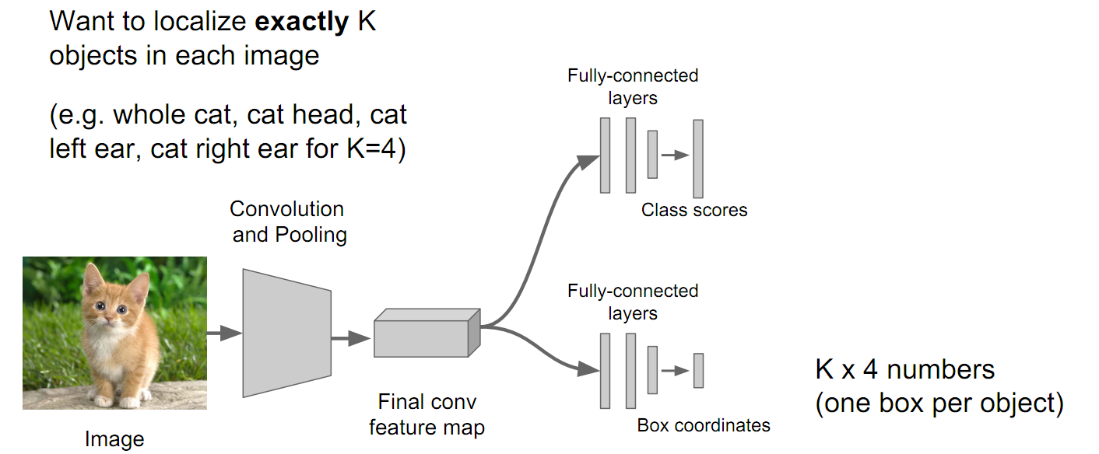
1. Localization
Localizing multiple objects
http://cs231n.stanford.edu/slides/winter1516_lecture8.pdf

Slide 12
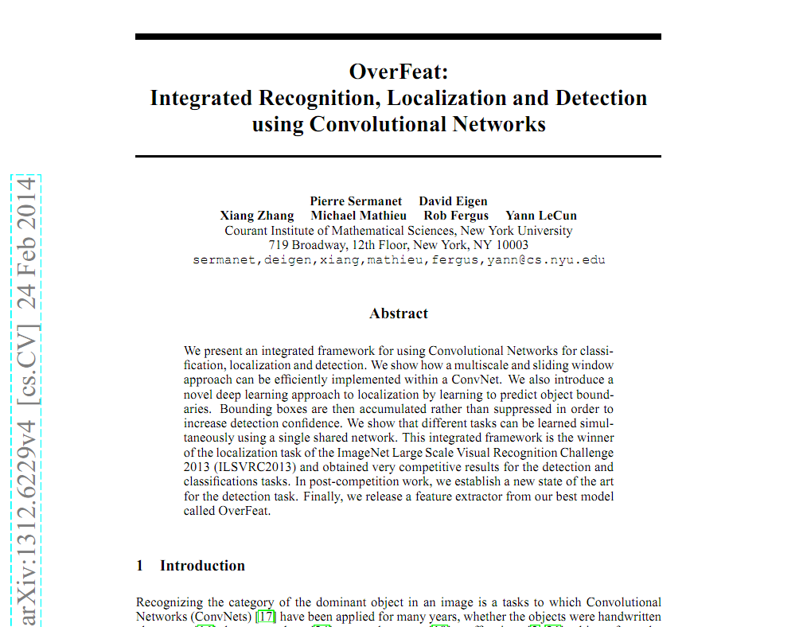
1. Localization
Sliding Window : Overfeat
뉴욕대에서 개발한 알고리즘으로 classification, localization, detection에 대한
통합 프레임워크를 제공하는 것을 목표로 개발
2013년 ILSVRC 대회의 localization 분야에서 1등, classification 4등, detection 3등
https://arxiv.org/pdf/1312.6229v4.pdf

Slide 13
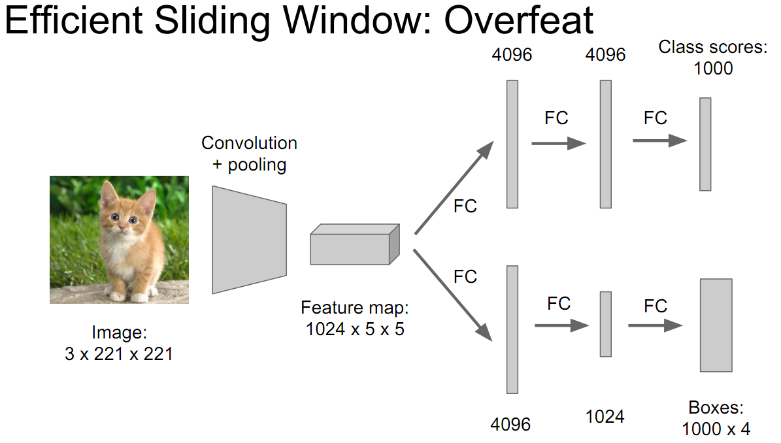
1. Localization
Sliding Window : Overfeat
http://cs231n.stanford.edu/slides/winter1516_lecture8.pdf

Slide 14
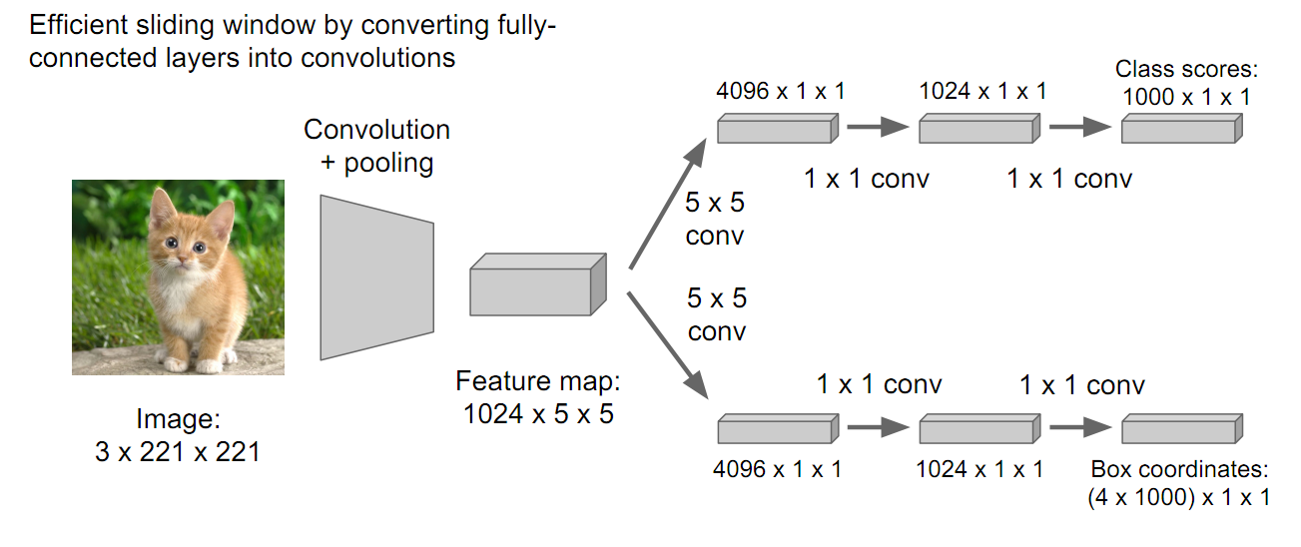
1. Localization
Sliding Window : Overfeat
http://cs231n.stanford.edu/slides/winter1516_lecture8.pdf

Slide 15
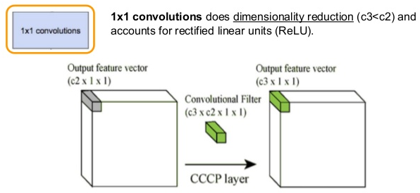
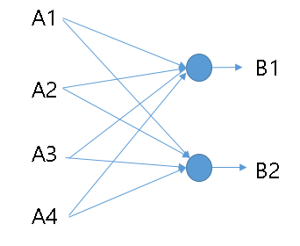
1. Localization
1x1 convolution
1-layer fully connected neural network와 동일 함
차원 축소를 할 수 있어, 연산량을 절감
Activation function으로 Relu를 사용하면
Non-linearity를 얻을 수 있음
http://laonple.blog.me/220692793375

Slide 16
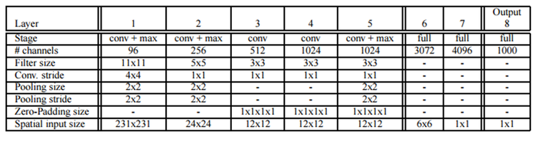
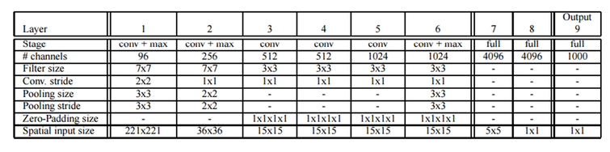
1. Localization
Sliding Window : Overfeat
Fast Model
Accurate Model
https://arxiv.org/pdf/1312.6229v4.pdf

Slide 17
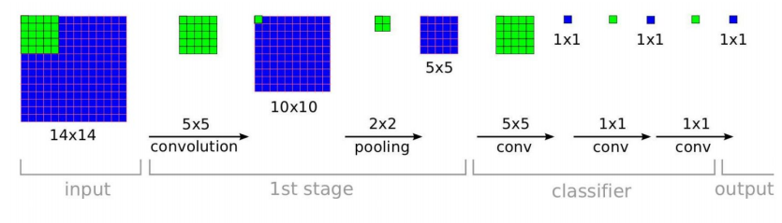
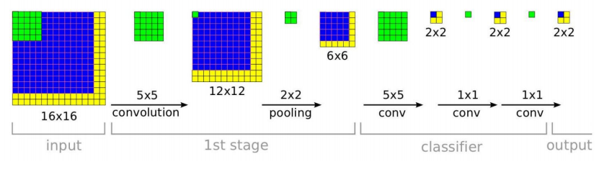
1. Localization
Sliding Window : Overfeat
Training time
Test time
https://arxiv.org/pdf/1312.6229v4.pdf

Slide 18
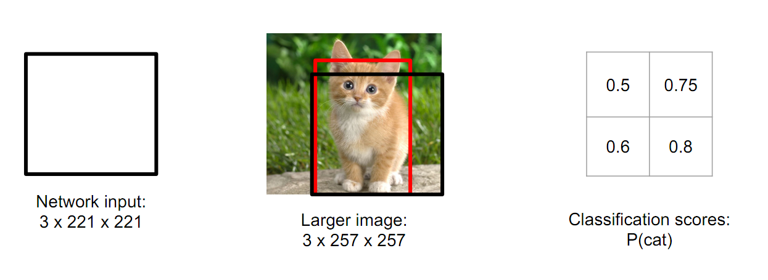
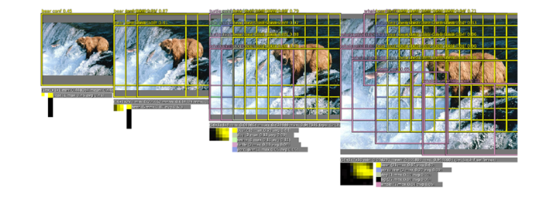
1. Localization
Sliding Window : Overfeat(classification)
https://arxiv.org/pdf/1312.6229v4.pdf

Slide 19
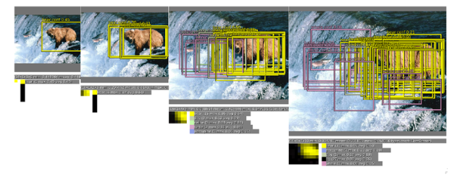
1. Localization
Sliding Window : Overfeat(regressor predictions)
https://arxiv.org/pdf/1312.6229v4.pdf

Slide 20
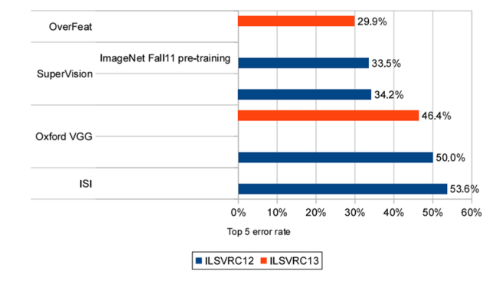
1. Localization
Sliding Window : Overfeat
http://laonple.blog.me/220752877630?Redirect=Log&from=postView

Slide 21
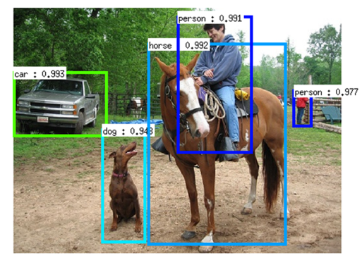
2. Detection
Object detection
http://cs231n.stanford.edu/slides/winter1516_lecture8.pdf

Slide 22
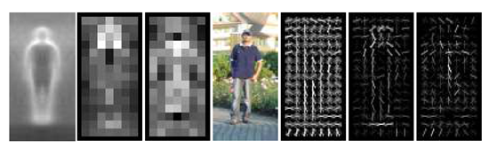
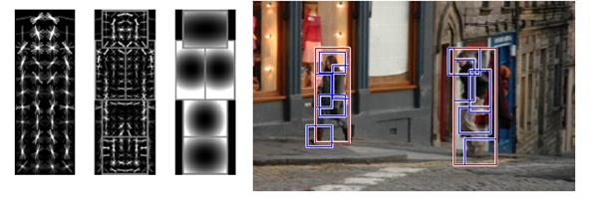
2. Detection
Pedestrian Detection
Dalal and Triggs, “Histograms of Oriented Gradients for Human Detection”, CVPR 2005
Slide credit: Ross Girshick
Felzenszwalb et al, “Object Detection with Discriminatively
Trained Part Based Models”, PAMI 2010
https://arxiv.org/pdf/1312.6229v4.pdf

Slide 23
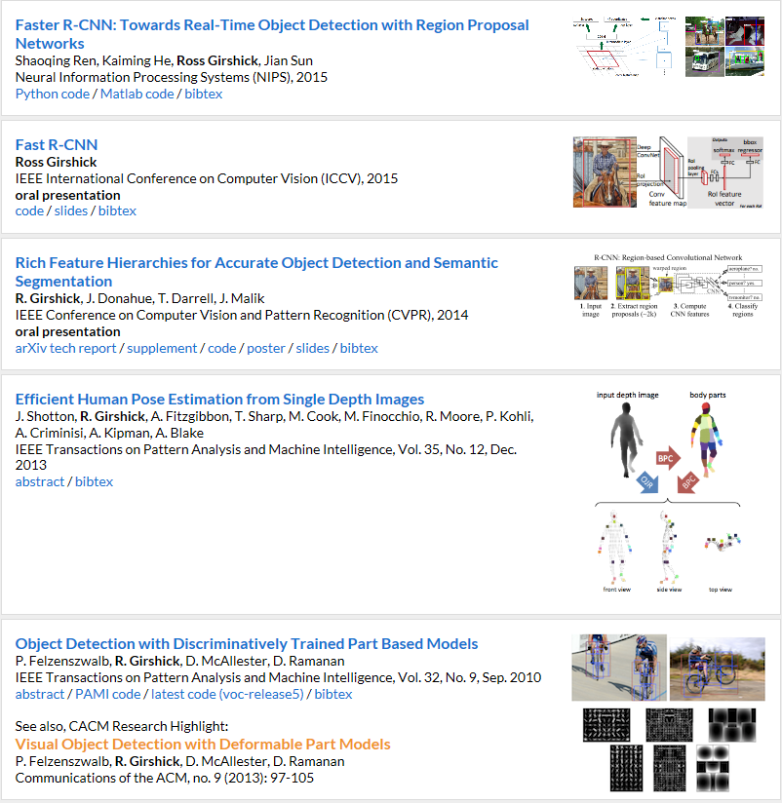

2. Detection
Ross Girshick
http://www.rossgirshick.info/

Slide 24
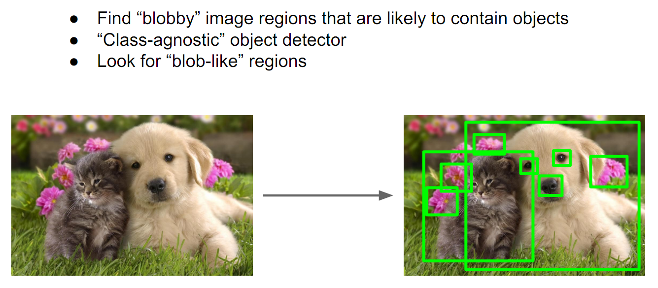
2. Detection
Region Proposals
https://arxiv.org/pdf/1312.6229v4.pdf

Slide 25
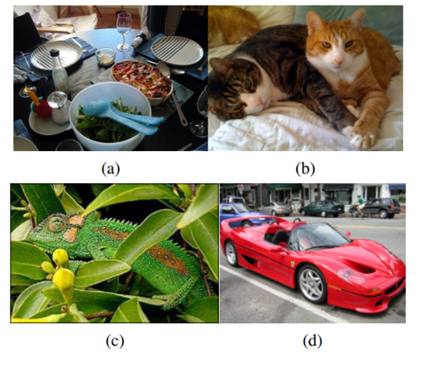
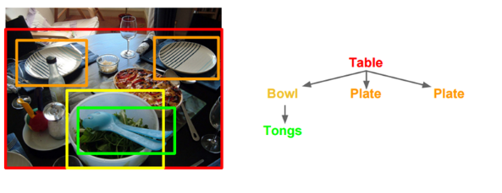
2. Detection
Region Proposals : Selective Search
http://www.huppelen.nl/publications/selectiveSearchDraft.pdf

Slide 26
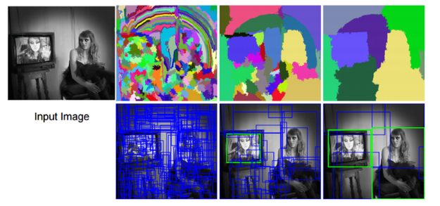
2. Detection
Region Proposals : Selective Search
http://www.huppelen.nl/publications/selectiveSearchDraft.pdf

Slide 27
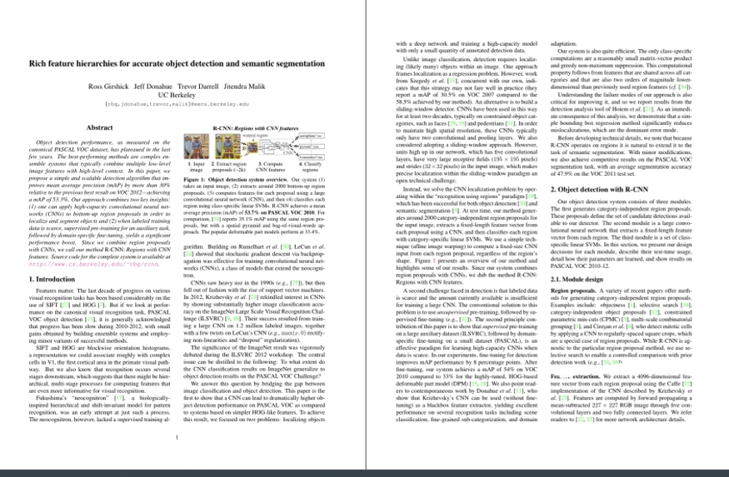
2. Detection
R-CNN
https://github.com/sjchoi86/dl_tutorials_10weeks/blob/master/ppts/Week7a%20Image%20detection%20(RCNN%2C%20SPPnet%2C%20FastRCNN%2C%20FasterRCNN).pptx

Slide 28
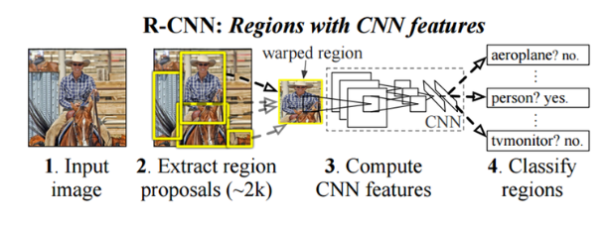
2. Detection
R-CNN
영상 입력
입력 영상으로부터 약 2000개의 후보 영역 만듬(Selective search)
Alexnet이 224x224 크기의 이미지를 받아들일 수 있으므로, crop/warp로 224x224 크기의 이미지로 만들고 CNN에 인가하여 최종 출력에서 해당 영상을 대표할 수 있는 CNN feature vector를 생성
Linear SVM을 이용해 해당 영역을 분류
https://arxiv.org/pdf/1311.2524v5.pdf

Slide 29
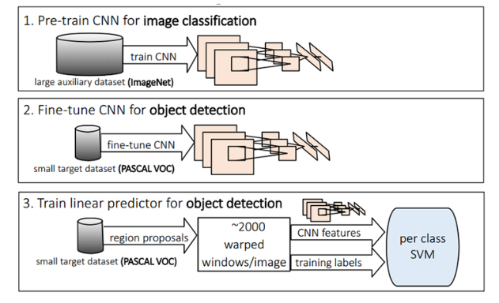
2. Detection
R-CNN
https://arxiv.org/pdf/1311.2524v5.pdf

Slide 30
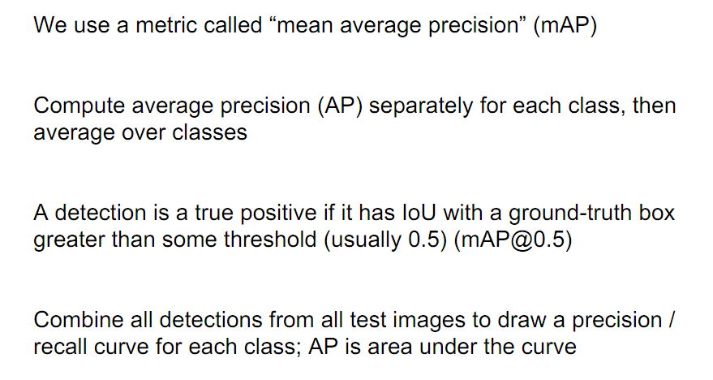
2. Detection
Mean average precision(MAP)
http://cs231n.stanford.edu/slides/winter1516_lecture8.pdf

Slide 31
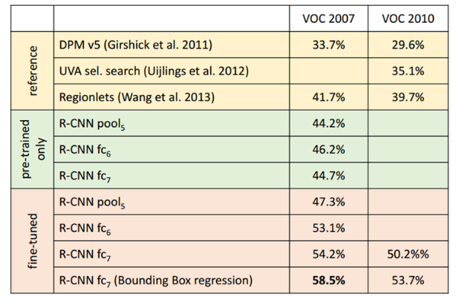
2. Detection
R-CNN
https://arxiv.org/pdf/1311.2524v5.pdf

Slide 32
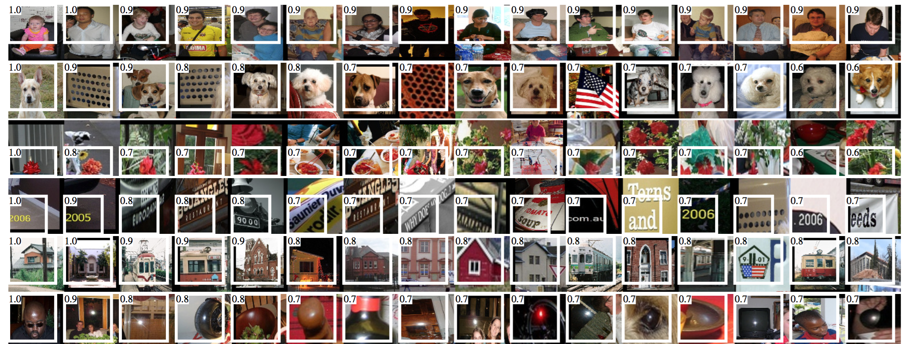
2. Detection
R-CNN
https://github.com/sjchoi86/dl_tutorials_10weeks/blob/master/ppts/Week7a%20Image%20detection%20(RCNN%2C%20SPPnet%2C%20FastRCNN%2C%20FasterRCNN).pptx

Slide 33
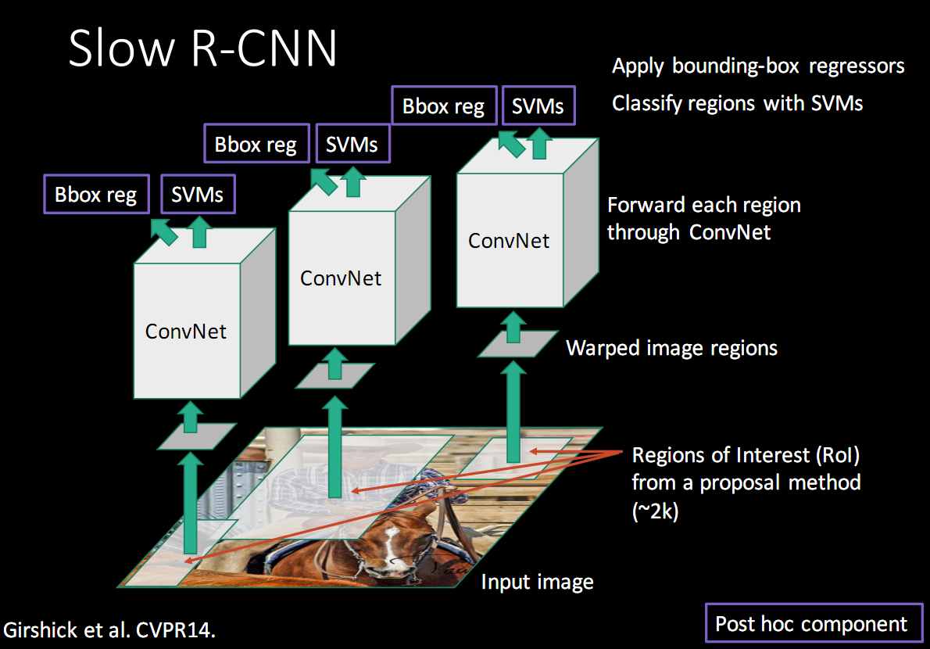
2. Detection
R-CNN의 문제점
1. Warp나 crop으로 인해
성능 저하가 발생할 수 있음
2. 2000여개의
Region proposal에 대해
순차적으로 CNN을 수행해야
되기 때문에 Run time이 긴 문제
3. Region proposal이나
SVM 튜닝이 GPU 사용에
적합하지 않음
http://www.robots.ox.ac.uk/~tvg/publications/talks/fast-rcnn-slides.pdf

Slide 34
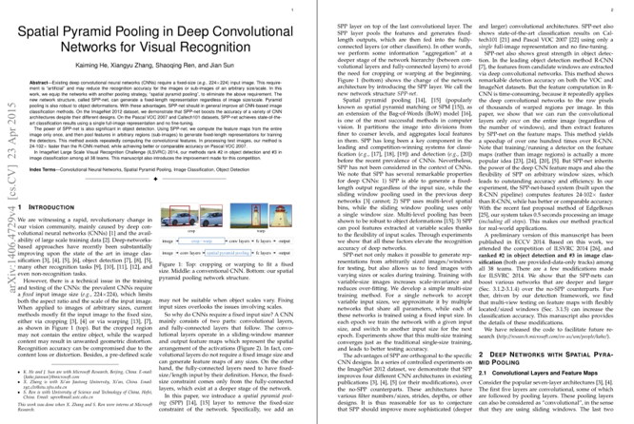
2. Detection
SPPnet
R-CNN의 단점을 개선
2014 ILSVRC에서 detection에서 2위, classification에서 3위
https://github.com/sjchoi86/dl_tutorials_10weeks/blob/master/ppts/Week7a%20Image%20detection%20(RCNN%2C%20SPPnet%2C%20FastRCNN%2C%20FasterRCNN).pptx

Slide 35
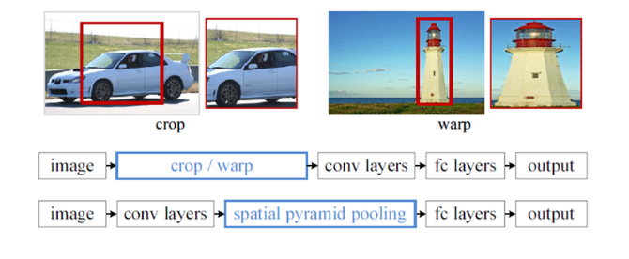
2. Detection
SPPnet
http://www.robots.ox.ac.uk/~tvg/publications/talks/fast-rcnn-slides.pdf

Slide 36
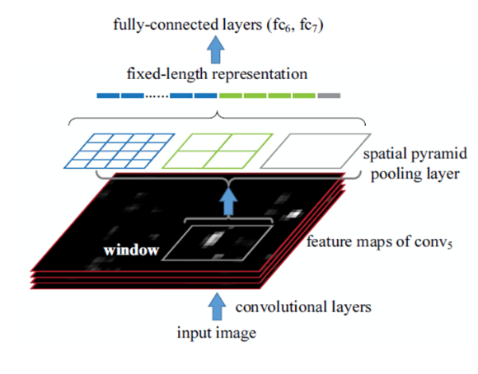
2. Detection
SPPnet
http://www.robots.ox.ac.uk/~tvg/publications/talks/fast-rcnn-slides.pdf

Slide 37
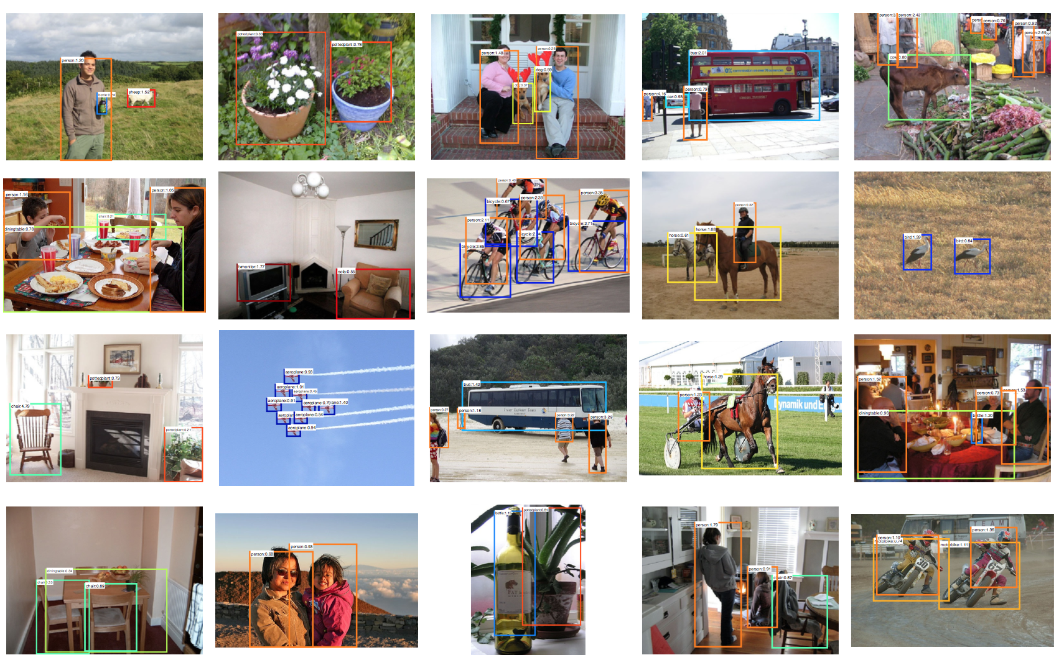
2. Detection
SPPnet
https://github.com/sjchoi86/dl_tutorials_10weeks/blob/master/ppts/Week7a%20Image%20detection%20(RCNN%2C%20SPPnet%2C%20FastRCNN%2C%20FasterRCNN).pptx

Slide 38
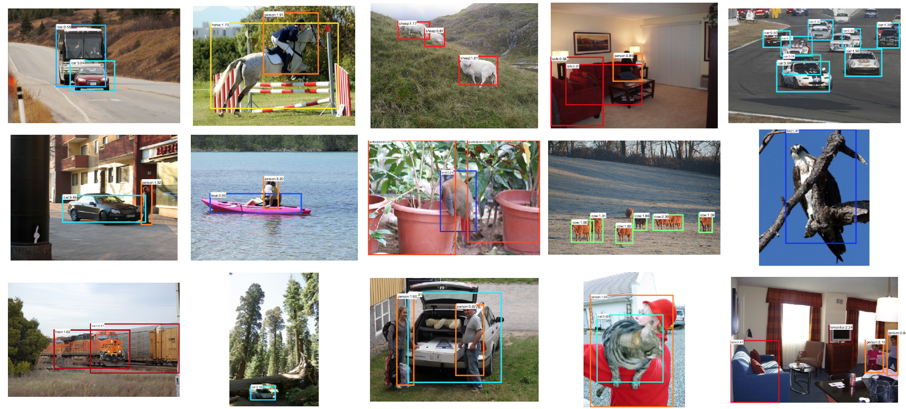
2. Detection
SPPnet
https://github.com/sjchoi86/dl_tutorials_10weeks/blob/master/ppts/Week7a%20Image%20detection%20(RCNN%2C%20SPPnet%2C%20FastRCNN%2C%20FasterRCNN).pptx

Slide 39
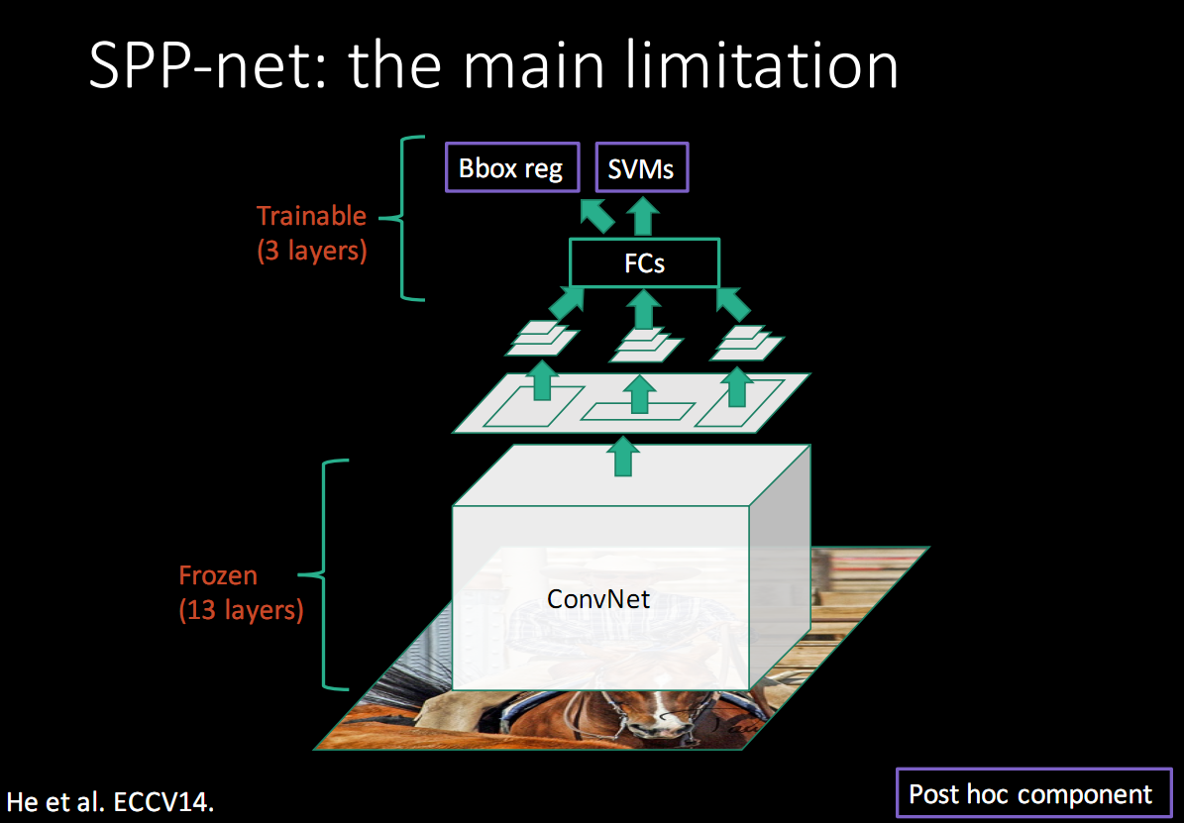
2. Detection
SPPnet의 문제점
Fine-tuning 알고리즘을 적용할 때 앞 단에 있는 convolutional layer에 대해 fine tuning을 하지 못하므로 deep network를 적용할 때 정확도가 문제 될 수 있음
http://www.robots.ox.ac.uk/~tvg/publications/talks/fast-rcnn-slides.pdf

Slide 40
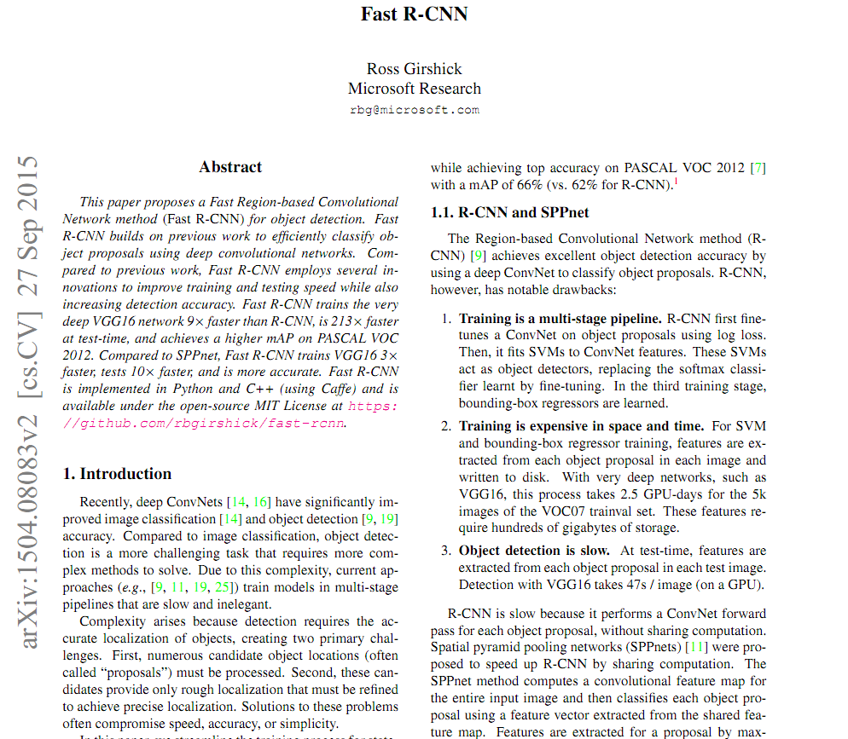
2. Detection
Fast R-CNN
https://arxiv.org/pdf/1504.08083.pdf

Slide 41
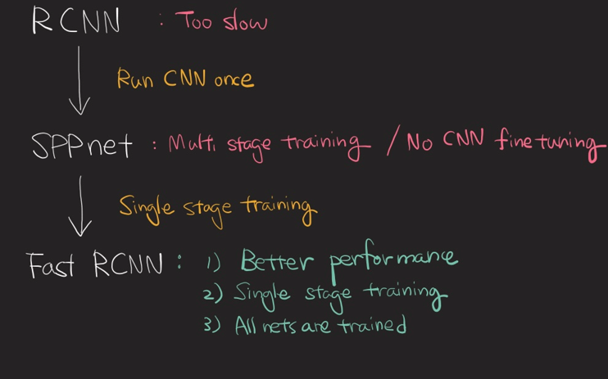
2. Detection
Fast R-CNN
https://github.com/sjchoi86/dl_tutorials_10weeks/blob/master/ppts/Week7a%20Image%20detection%20(RCNN%2C%20SPPnet%2C%20FastRCNN%2C%20FasterRCNN).pptx

Slide 42
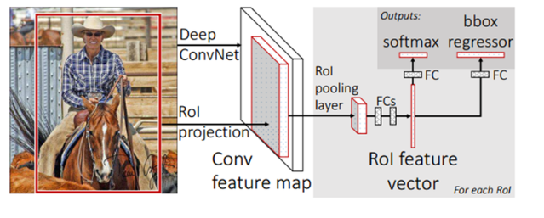
2. Detection
Fast R-CNN
https://github.com/sjchoi86/dl_tutorials_10weeks/blob/master/ppts/Week7a%20Image%20detection%20(RCNN%2C%20SPPnet%2C%20FastRCNN%2C%20FasterRCNN).pptx

Slide 43
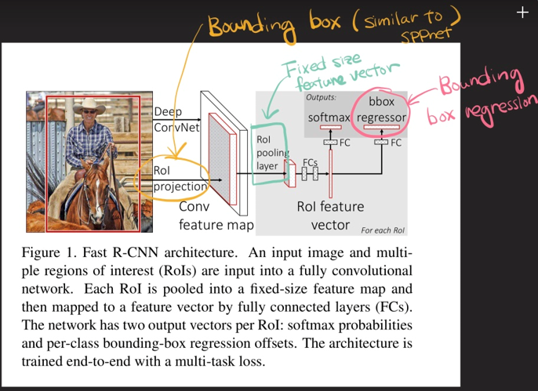
2. Detection
Fast R-CNN
https://github.com/sjchoi86/dl_tutorials_10weeks/blob/master/ppts/Week7a%20Image%20detection%20(RCNN%2C%20SPPnet%2C%20FastRCNN%2C%20FasterRCNN).pptx

Slide 44
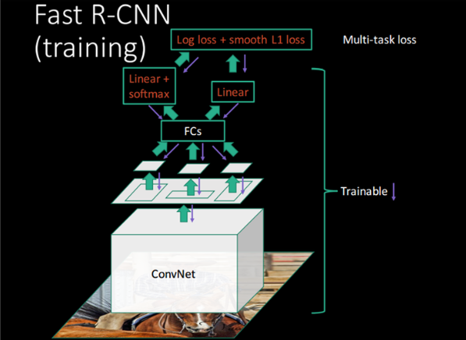
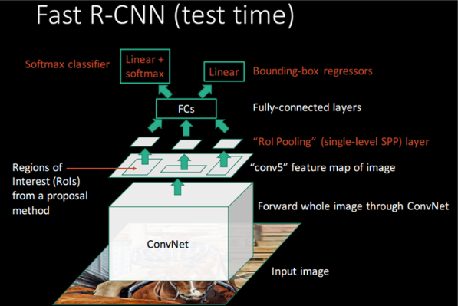
2. Detection
Fast R-CNN
https://github.com/sjchoi86/dl_tutorials_10weeks/blob/master/ppts/Week7a%20Image%20detection%20(RCNN%2C%20SPPnet%2C%20FastRCNN%2C%20FasterRCNN).pptx

Slide 45
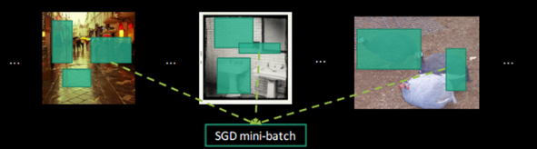

2. Detection
Fast R-CNN 학습 시간 감소
R-CNN, SPPNet
Fast R-CNN
https://github.com/sjchoi86/dl_tutorials_10weeks/blob/master/ppts/Week7a%20Image%20detection%20(RCNN%2C%20SPPnet%2C%20FastRCNN%2C%20FasterRCNN).pptx

Slide 46

2. Detection
Fast R-CNN 문제점
http://laonple.blog.me/220776743537

Slide 47

2. Detection
Faster R-CNN
http://laonple.blog.me/220776743537

Slide 48

2. Detection
Faster R-CNN
http://laonple.blog.me/220776743537

Slide 49

2. Detection
Faster R-CNN(RPN의 구성)
http://laonple.blog.me/220776743537

Slide 50

2. Detection
Faster R-CNN(RPN의 구성)
https://github.com/sjchoi86/dl_tutorials_10weeks/blob/master/ppts/Week7a%20Image%20detection%20(RCNN%2C%20SPPnet%2C%20FastRCNN%2C%20FasterRCNN).pptx

Slide 51


2. Detection
Faster R-CNN
http://laonple.blog.me/220776743537

Slide 52


2. Detection
Faster R-CNN with Resnet
http://laonple.blog.me/220776743537

Slide 53

2. Detection
Faster R-CNN
http://laonple.blog.me/220776743537

Slide 54
2. Detection
R-CNN
Image
Regions
Resize
Convolution Features
Classify
https://github.com/sjchoi86/dl_tutorials_10weeks/blob/master/ppts/Week7a%20Image%20detection%20(RCNN%2C%20SPPnet%2C%20FastRCNN%2C%20FasterRCNN).pptx

Slide 55

2. Detection
SPPNet
https://github.com/sjchoi86/dl_tutorials_10weeks/blob/master/ppts/Week7a%20Image%20detection%20(RCNN%2C%20SPPnet%2C%20FastRCNN%2C%20FasterRCNN).pptx

Slide 56

2. Detection
Fast R-CNN
https://github.com/sjchoi86/dl_tutorials_10weeks/blob/master/ppts/Week7a%20Image%20detection%20(RCNN%2C%20SPPnet%2C%20FastRCNN%2C%20FasterRCNN).pptx

Slide 57

2. Detection
Faster R-CNN
https://github.com/sjchoi86/dl_tutorials_10weeks/blob/master/ppts/Week7a%20Image%20detection%20(RCNN%2C%20SPPnet%2C%20FastRCNN%2C%20FasterRCNN).pptx

Slide 58

2. Detection
YOLO : You Only Look Once Detection as Regression
https://github.com/sjchoi86/dl_tutorials_10weeks/blob/master/ppts/Week7a%20Image%20detection%20(RCNN%2C%20SPPnet%2C%20FastRCNN%2C%20FasterRCNN).pptx

Slide 59

2. Detection
YOLO : You Only Look Once Detection as Regression
http://pjreddie.com/media/files/papers/yolo.pdf

Slide 60


2. Detection
YOLO : You Only Look Once Detection as Regression
Divide the image into a SXS grid.
If the center of an object fall into a grid cell, it will be the responsible for the object.
Each grid cell predict:
B bounding boxes x, y, w, h, confidence
B confidence scores C = Pr(Obj)*IOU
C conditional class probabilities Pr(${Class}_{i}\left|Object\right)$
Obtain the class-specific confidence score Pr(${Class}_{i}|Object)$* Pr(Obj)*IOU = Pr(${Class}_{i}$) * IOU
http://pjreddie.com/media/files/papers/yolo.pdf

Slide 61

2. Detection
YOLO : You Only Look Once Detection as Regression
http://pjreddie.com/media/files/papers/yolo.pdf

Slide 62

2. Detection
YOLO : You Only Look Once Detection as Regression
http://pjreddie.com/media/files/papers/yolo.pdf

Slide 63

2. Detection
YOLO : You Only Look Once Detection as Regression
https://github.com/sjchoi86/dl_tutorials_10weeks/blob/master/ppts/Week7a%20Image%20detection%20(RCNN%2C%20SPPnet%2C%20FastRCNN%2C%20FasterRCNN).pptx

Slide 64
감사합니다.

